Slide 1

INTRODUCTION TO WEB DEVELOPMENT
1
Code: COMP07009
Week 4
Reference: http://www.w3schools.com

Slide 2
CSS INTRODUCTION
2

Slide 3
CSS
3
Cascading Style Sheets
Defines a style for an HTML element or set of elements
Defines how HTML elements will be displayed
Styles were added to HTML 4.0 to keeps style and content separate
External style sheets (.css files) can save a lot of work as they enable you to change the appearance and layout of many pages in a Web site, by editing only one file

Slide 4
Where do I define CSS?
4
External style sheet
.CSS file
Internal style sheet
inside the <head> tag in the HTML file
Inline style
embedded inside the HTML element

Slide 5
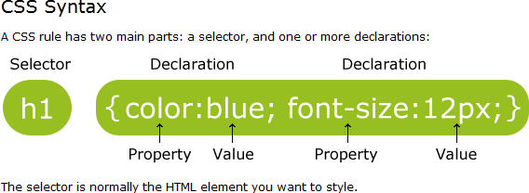
CSS Syntax (int/ext)
5
http://www.w3schools.com/css/css_syntax.asp
Each declaration consists of a property, colon and a value, ending with a semicolon
Some editors highlight parts of the syntax in different colours which is useful (eg Notepad++, HTML-Kit)

Slide 6
Useful styles
6
FONT
font-style:italic;
font-weight:bold;
font-size:large;
// also small, medium, 24px, 150%
font-family: "Times New Roman", Times, serif;
font-family: Verdana, Geneva, sans-serif;
TEXT
text-align:left;
text-decoration:underline;
text-transform:uppercase;
// also right, center
// also line-through
// also lowercase

Slide 7
Useful styles
7
BACKGROUND
background-color:pink;
background-image:url(logo.jpg);
background-repeat:no-repeat;
// also repeat, repeat-x, repeat-y
background-position:bottom right; // also top, center
BORDER
border-width:thin;
border-style:solid;
border-color:red;
// also medium, thick, 15px
// also dotted, double, dashed
border-image:url(border.png);

Slide 8
Rollover - Links
8
a:link
Defines the style for normal unvisited links.
a:visited
Defines the style for visited links.
a:active
Defines the style for active links.
A link becomes active once you click on it.
a:hover
Defines the style for hovered links.
A link is hovered when the mouse moves over it.

Slide 9
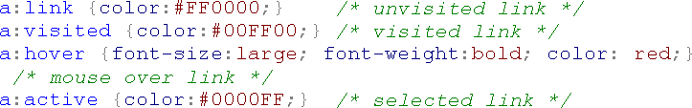
Rollover - Links
9
Eg When the user hovers over a link, it would appear larger, bold and colour red

Slide 10
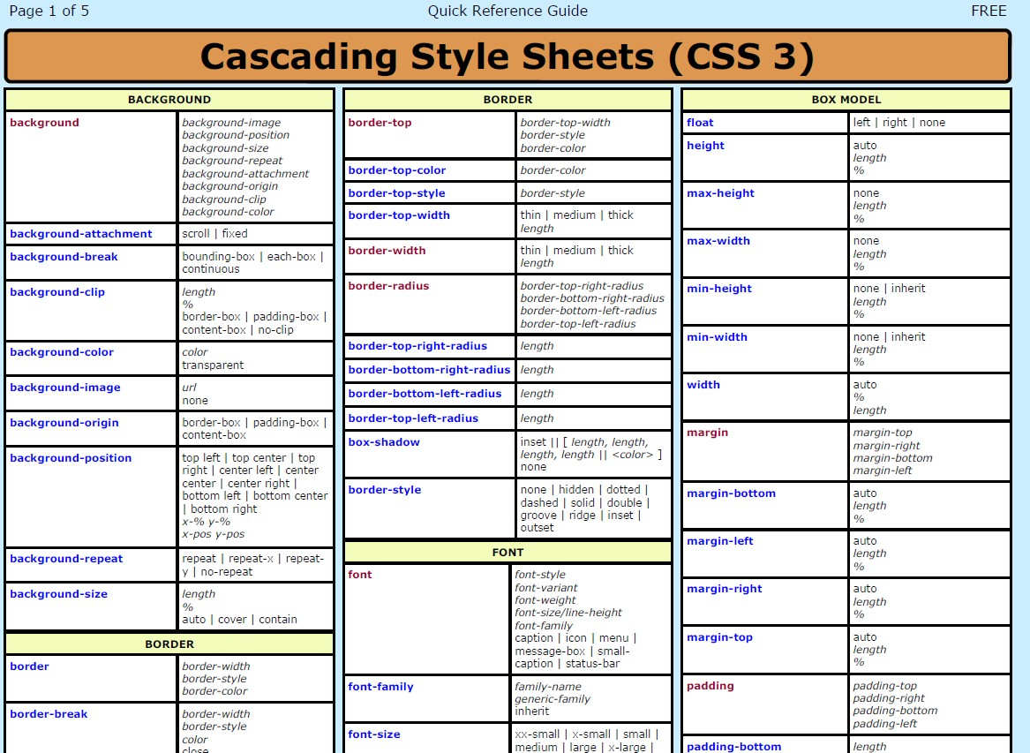
CSS Quick Guide
10
There is an extensive list of styles so it is recommended that you have a reference guide for CSS
Check out the guides added to Moodle

Slide 11

External CSS file
11
Defined within a separate file from HTML file
External file has .css extension
Most common way of applying styles
Does not contain any HTML code
Can be written in any text editor
Must link the to the style sheet from the html file using the
<link> tag inside the <head> tag

Slide 12
Grouping selectors
12
Define the header1, header2 and header3 elements to have a colour of red
h1,h2,h3 {colour:red;}

Slide 13
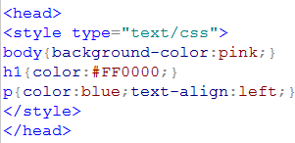
Internal Style Sheet
13
Defined inside the <head> tag within the HTML file using the <style> tag
Does not contain any HTML code
Can be written in any text editor
Applied within the current document only so should be used when a single document has a unique style

Slide 14

Inline style
14
Mixes content and presentation
<style> tag is used inside the relevant tag
Only applied to the single element
Time consuming and repetitive
Not recommended

Slide 15
Multiple Style Sheets
15
If some properties have been set for the same element in different style sheets, the values will be inherited from the more specific style sheet
Cascading order
The styles will "cascade" by the following rules, where number four has the highest priority:
Browser default
External style sheet
Internal style sheet (in the head section)
Inline style (inside an HTML element)

Slide 16
CSS references
16
Useful to print out reference list or bookmark relevant sites for quick reference as you’re not expected to remember all possible properties and values
Eg CSS Background
Properties are used to define the background effects of an element
What are they?
background-color
background-image
background-repeat
background-attachment
background-position
http://www.w3schools.com/css/css_background.asp

Slide 17
CSS comments
17
Used to explain the code so may help you edit at a later date
CSS comments begin with /* and end with */
/* this is a CSS comment */
Comments will be ignored by the browser

Slide 18


ID Attribute
18
Defines a style for a single, unique element
There can only be one element of a given type with a given ID in a document
Use the hash (#) to specify an id
Any HTML element can have ID attribute:
<h1 id=“intro”>This is a heading</h1>

Slide 19


CLASS Attribute
19
Defines a style for a group of elements
Unlike id, class is often used on many elements
Can be defined as a general style that can be used by different elements using a “.” before the name of the class
The class is applied to the <h1> and <h2> elements using the class attribute

Slide 20


CLASS Attribute
20
Can be defined so that only specific HTML elements should be affected by a class
Give the element name before “.” and the name of the class
Only <p> tags will be affected by this class
Different classes can also be applied to different instances of the same element
Two different classes can be applied to the <p> element

Slide 21
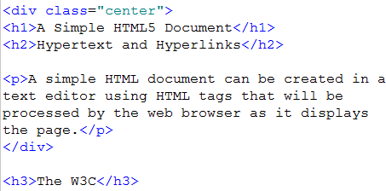
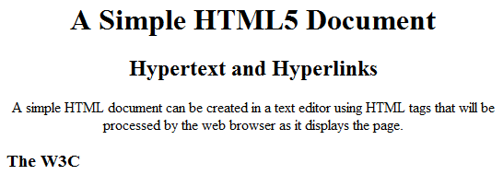
DIV
21
<div> tag used to layout a web page (which will be looked at later)
Can be used to group elements to format them with CSS

Slide 22


SPAN
22
Used to group inline elements in a document
Provides a way of setting the style for part of a text or part of a document

Slide 23
CSS - LAYOUT
23

Slide 24
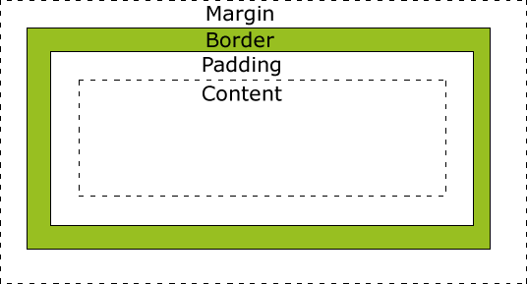
CSS Box Model
24
All HTML elements can be considered as boxes
Term “box model” is used for design and layout
Box that wraps around HTML elements

Slide 25
CSS Box Model
25
Margin - Clears an area around the border. The margin does not have a background color, it is completely transparent
Border - A border that goes around the padding and content. The border is affected by the background color of the box
Padding - Clears an area around the content. The
padding is affected by the background color of the box
Content - The content of the box, where text and images appear

Slide 26

Width and Height
26
When you set the width and height properties of an element with CSS, you just set the width and height of the content area. To calculate the full size of an element, you must also add the padding, borders and margins.
Total element width = width + left padding + right padding
+ left border + right border + left margin + right margin
Eg
Total width of the element is 300px
250+2x10+2x10+2x5

Slide 27
Structure of a Page
27
New structural elements in HTML5
<header> Defines a header
Eg logo, navigation menu, web site details
<footer> Defines a footer
Eg copyright, contact details
<hgroup>
a
<article>
Groups a set of <h1> to <h6> elements when
heading has multiple levels
Defines an article
Eg An independent block of content

Slide 28
Structure of a Page
28
<aside> Defines content aside from the page content
Eg not directly related to article content
<nav> Defines navigational links
Eg navigational menu
<section> Defines a section in a document
Eg groups related content together
And many more ....

Slide 29
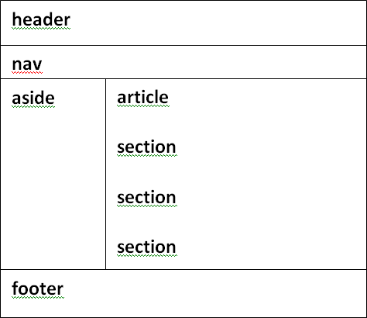
Example
29

Slide 30
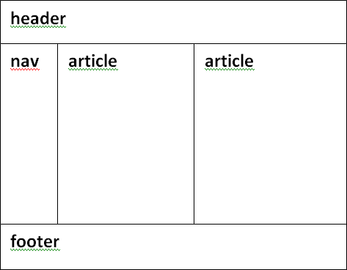
Example
30

Slide 31
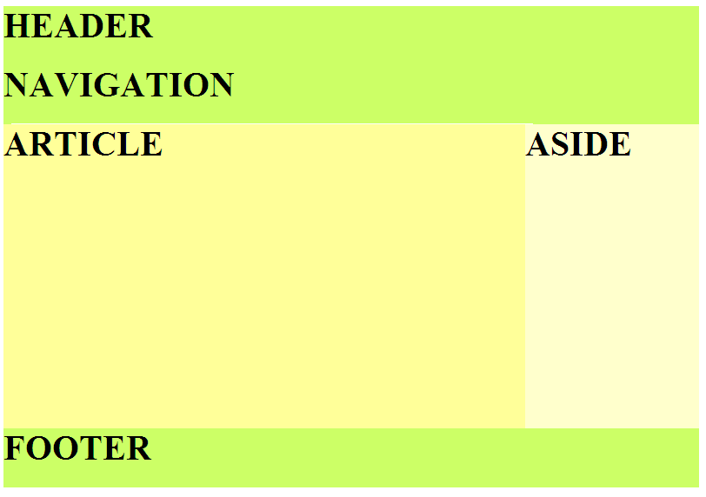
Example
31

Slide 32
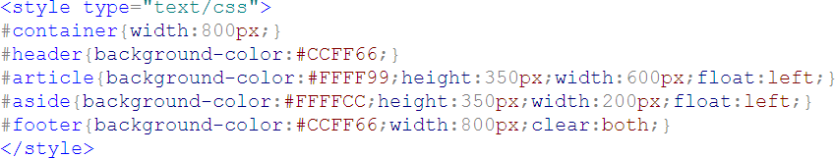
Inside <head>
32
<style> tags
# followed by name of id
CSS syntax {property:value;property:value etc}

Slide 33
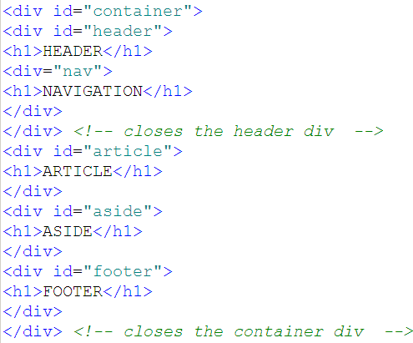
Inside <body>
33
Everything inside the container
Navigation inside the Header

Slide 34
Example
34
header color
nav color height width float alignment | content color height width float
footer

Slide 35
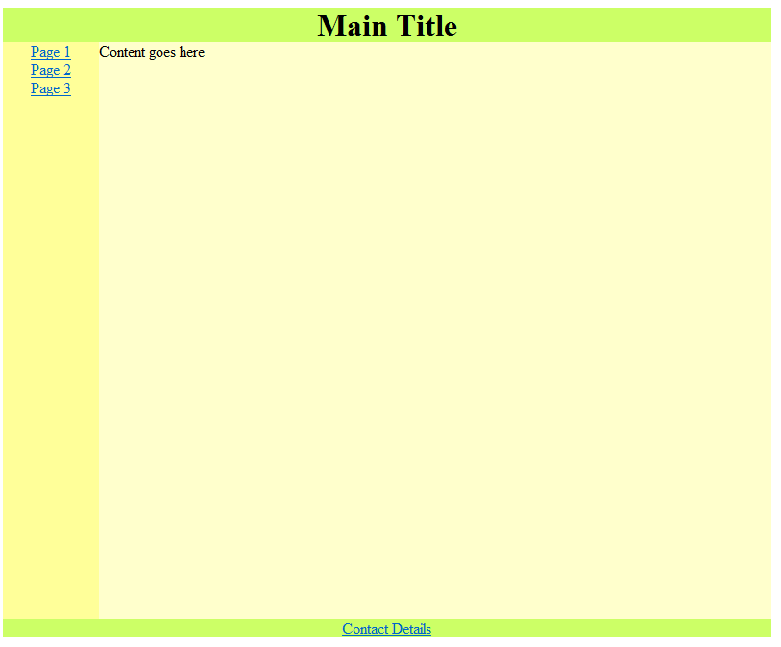
Example
35

Slide 36
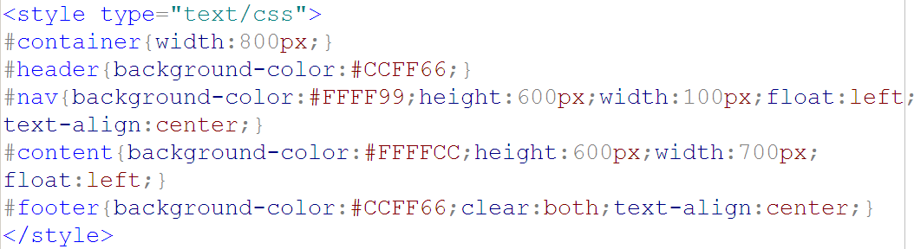
Inside <head>
36

Slide 37
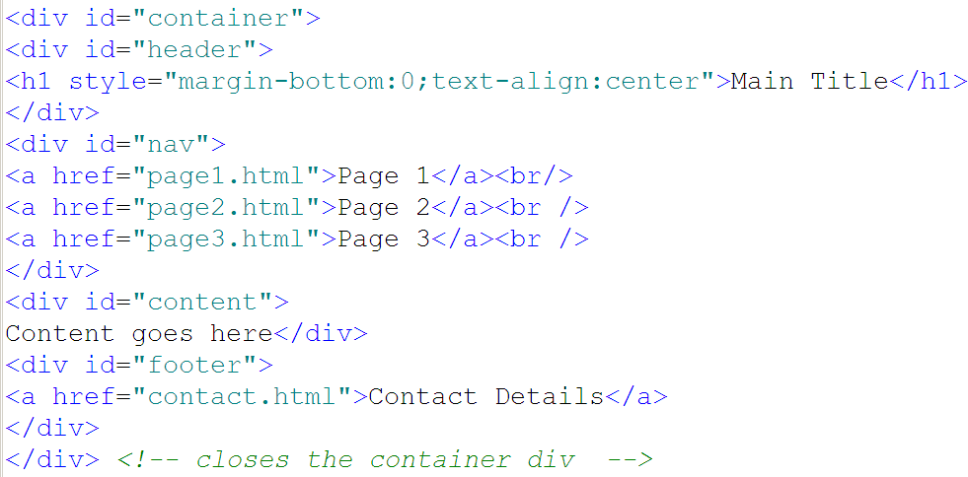
Inside <body>
37

Slide 38
Finally ....
38
CSS is recommended for layout and NOT tables
Browser Compatibility Issues
Use Internal and External Styles and try and avoid inline styles
Use reference lists for CSS
eg http://w3schools.com/cssref/default.asp
Your lecturer will demonstrate some examples of CSS for
styling and layout.

Slide 39
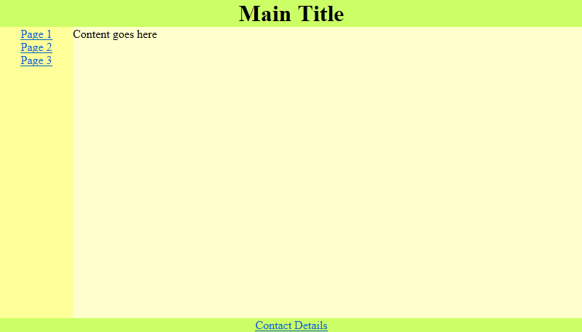
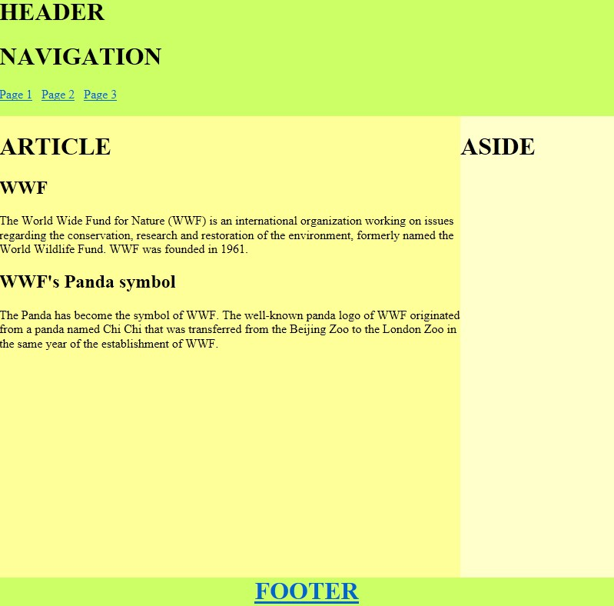
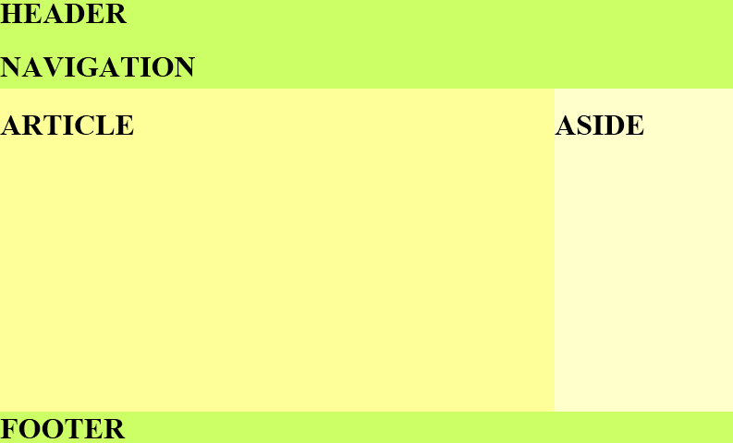
CSS Layouts
39
There are CSS layout examples on Moodle
Download them and look at the code and make changes to give other layouts for a web page

Slide 40
Assessment 1
40
You should be working on your first assessment which is available on Moodle.
Your lecturer will have demonstrated some previous assessments (with a different assessment theme) to give you an idea on other student assessments.
Remember focus on the breakdown of marks for the first assessment.
Part of this assessment requires you to show a different layout for the home page and the detail pages
Start working on what type of layout you intend for your
web pages

